Slide 2

Write effective CVs & Covering letters
Stand out from
the crowd!

Slide 3

Learning outcomes
Understand the purpose of a CV & Covering Letter
Know what to include in a CV and Covering letter
Understand how to structure a CV and Covering letter in order to market yourself effectively
Understand how to target your CV and Covering letter to specific opportunities
Be aware of the support available via the Careers Service

Slide 4
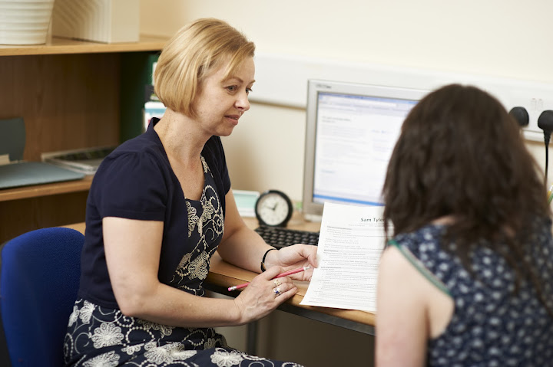
What is a CV?
Your marketing document, subjective and personal to you
An up to date portfolio of your skills and experience which are relevant to a particular post
Informative but concise
Designed to get you an interview, not a job
“Persuasive sales document selling you (the product) to an employer (the customer)" – Employers’ definition

Slide 5

When to use/Why have a CV?
Requested by an employer/recruitment agency
Asked to apply in writing
Making speculative applications – employment or work experience
Making applications for PhD/Postgraduate courses – check requirements first
For careers fairs
As a reference document for
application forms

Slide 6

Why do Employers Use CVs?
To shortlist candidates for interview
To see how you present yourself on paper
May take just 15 seconds to skim a CV and make a decision
May use software to scan for key words
Your CV needs to match the
employer’s requirements as much
as possible

Slide 7
Selecting information
An effective CV is:
Targeted to the job for which you’re applying
Accurate, interesting and up to date
Accompanied by a Covering letter
To achieve this:
Identify the employer’s criteria
(what are the key skills, experience required for post?)
Select appropriate evidence (from any aspect of your life) to show that you match their criteria
Take advice from others

Slide 8
Content may include the following
Personal details
Work
experience
Skills
References
Education/
qualifications
Career
goal
Voluntary
work
Employment
history
Achievements
Current
studies
Dates
Positions of
responsibility
Personal
profile
Other activities

Slide 9
Disaster CV
It may seem obvious that this is not an acceptable CV ,but the process of identifying all the classic mistakes and discussions as to how to improve this CV should help you recognise how you should go about writing your CV.

Slide 10
Curriculum Vitae
Personal details
Name; Di Saster
Date of birth; 29/02/1995
Address; 13 Hapless Road, London
Telephone; 0852 5428654
Sex; Female
Marital Status; Single
Nationality; British
Education
1983-1987 Hapless Road Junior School 1987-1994 Hapless Road Senior School: 10 GCSEs, 4 A levels - Economics, History, Maths, General Studies 1994 - to date Any University, Anytown, studying for a BA inEducational Studies
Work History
1988-1989: Paper Round for ABC Newsagents Delivered newspapers for 50 people 1994-1995: Assistant Bar Manager for the Pink Flamingo, Anytown I became familiar with the full range of products supplied in the bar and enjoyed striking up a rapport with customers. (Left after disagreement with the manager)
Extracurricular Activities
Entertainments Officer for the University Drinking Society Captain of the University Women's Hockey Team
General Skills
Conversational Mandarin Word Procesing Skills Driving Licence (7 points)
References
Dr Jones, Any University, Anytown Mr Derek Saster 13 Hapless Road, London

Slide 11
Targeting your application
Use the Job Description and Person specification to target your application to the employer’s criteria
Job description: information about the job (key responsibilities and duties). May include details of key skills, qualifications and personal qualities required
Person specification:
List of the key skills, personal qualities and qualifications required and whether they are essential or desirable (often presented in table format). May also state how criteria will be assessed (application, interview, skills test…)

Slide 12

Targeting Your CV: Skills and Qualities most Requested by Employers
Self management
Communication
Team working
Problem solving
Creativity & innovation
World of work/commercial awareness
Social, cultural & global awareness
Application of IT
Numeracy
Discipline specific

Slide 13
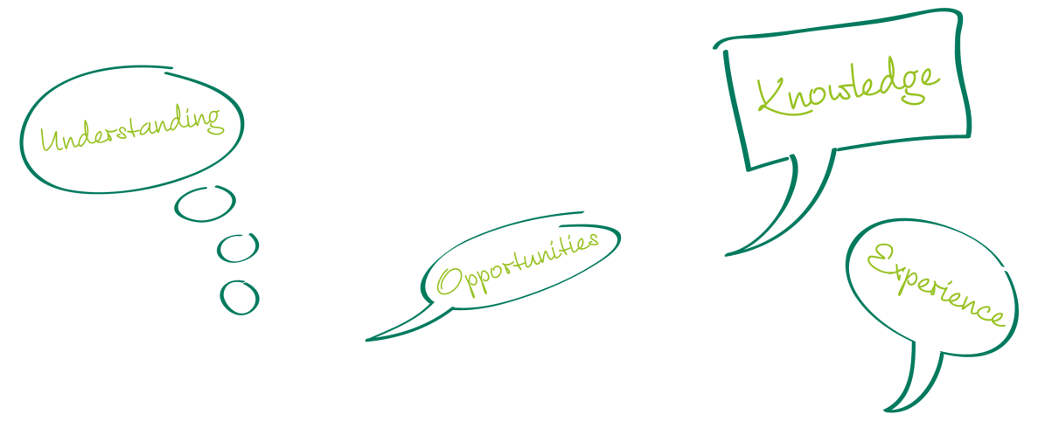
Think employability skills
From:
Degree
Work experience
Voluntary work
Leisure
University life
Previous life/lives!
CBI survey November 2008
78% of senior executives agreed
that employability skills are
the most important factor when hiring

Slide 14
Identifying skills from your experiences–think CAR
Context –situation and tasks
what/where/when/with whom?
Action
what did you do?
Result
what happened? what outcome?
Notes:
Students to prepare answer to questions – see next slide

Slide 15

Go to the What am I good at? section of Employability tutorial if you want help to identify the gaps in your skills.
http://vle.york.ac.uk/

Slide 16
HE Academy – skills from Economics http://studyingeconomics.ac.uk/employability-profile/
Abstract and simplify in order to identify and model the essence of a problem
Analyse and reason – both deductively and inductively
Marshal evidence and to assimilate, structure and analyse qualitative and quantitative data
Communicate concisely results to a wide audience, including those with no training in Economics
Think critically about the limits of one’s analysis in a broader socio-economic context
Draw economic policy inferences and to recognise the potential constraints in their implementation
Apply literary and information-processing skills, as well as interpersonal skills

Slide 17

Compiling a CV: Personal Details
Essential:
Name and contact details (address, phone number, e-mail)
Optional:
Nationality (mention if work permit not required)
Not required (in UK):
Age
Marital Status/Number of dependants
Gender
Photograph
The above will vary between countries (see www.prospects.ac.uk for country specific information)

Slide 18

Career goal/personal statement
(optional)
Keep it focused to the job/career
Be concise
NOT:
A cheerful, hardworking person who gets satisfaction from working in a team and on my own. I am enthusiastic and set myself high standards.

Slide 19
Example personal profiles
A PEP graduate with research skills developed through project work and an internship, looking for a career in a political consultancy.
A highly motivated final year student with relevant experience gained at an independent production company and through wide ranging involvement with York university’s award winning student media.
A 3rd year Economics student with commercial awareness and good analytical and numerical skills developed through my degree and from internship experience with McKinsey, eager to make a career in Management Consultancy.

Slide 20

Education/qualifications
Consider how much detail? (reverse
chronology)
Subject knowledge? (modules, projects, dissertation)
Transferable skills? (analytical, team work, problem solving etc)
Pre –university qualifications – keep brief – consider their relevance
Non-UK – describe qualification as achieved e.g. International Baccalaureate 67.5%

Slide 21
Work Experience – paid/voluntary
Reverse chronology
Consider relevance of jobs – do you need to include everything ?
Think tasks ,skills and achievements.
Consider themes: e.g. administrative; finance related; retail; relevant/other. Group them as relevant to the job for which you are applying.
Notes:
Mention separate section for “Relevant Work Experience” – very important.

Slide 22
Skills from your experiences
Activity | Task | Skill
Working in a pub | Dealing with public Handling cash Working long hours in a busy environment | Customer care Communication Conflict resolution Numeracy Accuracy Time management, Energy Working under pressure

Slide 23
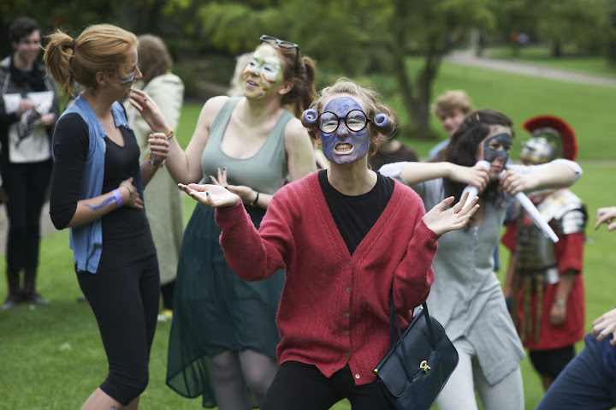
Additional Sections
Achievements and Positions of Responsibility
Voluntary work
Additional skills (IT, languages)
Interests/extra curricular activities
References (names & contact details or available on request)

Slide 24

CV formats: chronological
Outlines your career history in date order, beginning with the most recent items (reverse chronology)
Includes details of skills within relevant sections
Conventional approach and easiest to prepare
Works well for students with a good all round mix of education and work experience

Slide 25
Alexander Thoday Tel: 01904 777777 Mobile:7777777777
11 West St
York YO103DD Email: at@hotmali.com
Education
2009-12 Economics and Economic History BA (Hons.) Predicted: 2:1 University of York
Expanded and acquired analytical skills through applying the concepts and logic of mathematics
Critically evaluated a range of economic and social data
Considering the way ideas evolve over time has involved surveying a broad spectrum of resources and making independent inferences about their bearing.
2002-9 The School, The Town
A level: Economics A; Geography A; English A; General Studies B
GCSE: 10 subjects at A* -A
Work experience
2011 Intern KPMG
Completed vacation scheme in tax department, giving an insight into the fundamental aspects of a large professional services firm
Responsibilities included verifying financial data, preparing presentations, attending strategic meetings and working as part of a team assigned to a marketing project.
Gained an understanding of technical issues, including the use of software packages.
Socially responsible policies of the company presented the chance to support community projects, promoting a strong sense of reward.
Interacting with colleagues from different levels within the business, demonstrated the importance of diligent written and oral communication.
2009 – present Student Ambassador, University of York
Work with a team contacting graduates to update the alumni database; requires succinct and flexible communication
Fundraising for the university’s Annual Scholarship Fund requires a confident and articulate approach
Awarded ‘top student of the campaign’ prize
2007 Data Analyst, Forest Hill Accountants
A summer placement working with financial data; gave practical application of a range of numeracy skills
Adhering to deadlines was essential, requiring excellent time management and resilience

Slide 26
Positions of Responsibility
2011 Vice Chair, University of York Economics Society (elected position)
Working with a group to manage budgets, corporate relations and events organisation
Organised programme of speakers from large financial organisations
Required effective teamwork, leadership and proactive motivation of others
2008-9 Head of The School
Required flexibility and the ability to take initiatives through to their conclusion
Required public speaking, resourcefulness and diplomacy
2004 -9 Regimental Sergeant Major, CCF
Membership of the Combined Cadet Force led to promotion to the highest possible rank
Maintained excellent standards of dress, organisation and teaching throughout the ranks, requiring determination and the ability to delegate.
Other interests
Duke of Edinburgh’s Award
Completed Bronze and Silver awards requiring sustained commitment through charity work and expeditions
Piano playing
Playing a range of contemporary and classical music led to working in The Horse and Groom Restaurant at weekends and special occasions. Met a diverse range of people and developed my interpersonal skills in a new context
Travel
2010 and 11 Trekking in Peru and other areas of S America gave me a range of unforgettable experiences and the chance to obtain a scuba diving qualification, as well as the chance to learn about and experience life in different cultures and environments
References: Available on request

Slide 27
CV formats: Skills based
Highly focused CV which relates your skills and abilities to a specific job or career area
Particularly good for career changers/mature graduates
Highlights skills and major achievements
Minimises impact of unrelated work experience
Saves repeating similar details in similar jobs

Slide 28
Daniel Jones
151 Any Road, York YO10 3AB
0789695949 abc123@ tiscali.co.uk
Personal Profile
A determined and enthusiastic Politics and Economics undergraduate, predicted to achieve 2:1, keen to use knowledge and skills developed in work experience and voluntary roles to progress within a public sector human resources role.
Skills
Communication and interpersonal
Worked effectively in teams in both academic and work environments
Experience in hospitality has developed effective listening skills to identify client’s specific needs, in both luxury hotel and city centre bar
Meeting and discussing student issues with academics as Board of Studies Representative required the ability to articulate clearly and to negotiate
Working to deadlines and under pressure
Late nights and early mornings required for preparations for book launch in hotel. Needed appropriate power supplies, contingency plans and a professional approach to challenging clients.
Joint responsibility for the organisation of large scale fundraising events. Prioritised activities effectively, especially during exam periods
Delivery of high quality work, taking responsibility for decisions
Accountable to and representative for a large and diverse group of students as elected president of the Mature Student Association.
Objectivity, accuracy and consistency required as a Mystery Shopper
Planning & organisation
Planned, budgeted and organised extensive, independent overseas expeditions, most recently to China by train. Required adaptability and determination
As an English teacher - designed lessons meticulously, ensuring appropriateness for all classes
Effective time management and self discipline has brought academic achievement while working and holding positions of responsibility
Self awareness to improve own performance
Realised limitations while working for a small school with limited resources in Inner Mongolia. Used on-line forums extensively to exchange ideas, advice and resources from overseas
Developed Negotiation skills through pursuing additional course at university
Language skills
Native English and Welsh speaker, also studying Mandarin.
Basic knowledge of Greek and conversational level French
Computer skills
Excel and Word used daily and Power point regularly
Confident with publishing and photo-editing suites such as PhotoShop, Draw and Publisher
Basic knowledge of HTML

Slide 29
Education
2009 -12 BA Politics and Economics University of York 2:1 expected grade
Developed an excellent understanding of political systems and the ability to interpret political issues and events.
Developed financial/business awareness from a global perspective
2004-8 Mayfield Comprehensive, Newtown
A levels: Biology A; Physics A; Chemistry B
GCSEs: 11 A* -B including English and Maths
Work Experience
10/2009 - present Mystery shopper GRG Research
Undertaking research into customer service in a variety of retail establishments
10/2009 – present (vacs) Grand Hotel, Newtown
Waiter – developing further customer service experience
Events organiser – planning and delivering book launch event
08/2009- 10/2009 Barman Queen’s Head, Newtown
Working in a team in a busy, pressurised environment
10/2008- 06/2009 Teacher of English, New World Language School, Mongolia
Planning and delivering lessons to young learners, while adapting to a new culture and language
Positions of Responsibility
2010-11 Board of Studies Representative for academic department University of York
Liaison between academic staff and students; seeking and understanding student issues and concerns; attending committee meetings; reporting back.
2010-11 President of Mature Students Association, University of York
Chairing a committee working to further student interests, including planning and developing a social programme.
2009-present Fund raiser for Cancer Research
Being creative with ideas and planning and organising student events
Interests
Travel – independent travel in vacations to China, USA and within Europe. Expanding my awareness of different cultures
Judo – holder of Brown belt
Cooking - Keen on experimental cooking and trying new recipes from around the world.
References Available on request

Slide 30
CV Formats: ‘Creative’ CVs
Useful in certain sectors, e.g. media/creative arts
Stand out/be remembered/attract attention
Demonstrate design skills/creativity
Be aware of the advantages and disadvantages of this approach.
Making a more visual CV may help you to arrange your ideas, even if your final CV is more traditional.
Two examples follow

Slide 31

CV Formats: ‘Creative’ CVs
Creative CV (full version) by Jonathan Frost (York)
Guardian careers blog article

Slide 32
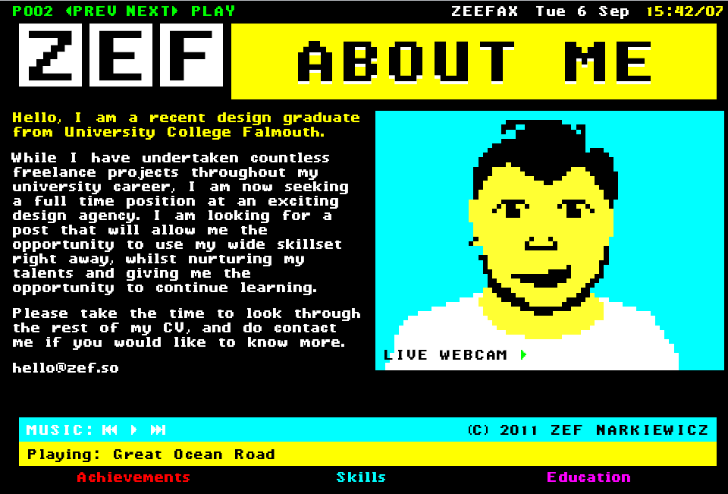
CV Formats: ‘Creative’ CVs
Retro interactive online CV

Slide 33

Tips for content
Do:
Use headings which are appropriate to you and to the job
Give some detail of what you have gained from your course
Keep the content concise and focussed
Focus on positive achievements
Use positive words
Provide evidence for any skills you claim to have
Don’t:
Give long lists of duties without reference to skills acquired
Start sentences with ‘I’

Slide 34
Tips for layout
Do:
Two A4 pages-print 11 or 12
Leave some white space but not too much!
Consider bullet format to avoid large blocks of text
Separate the sections clearly – using appropriate headings
Double-check spelling, punctuation and grammar
Don’t:
Use the heading CV or Curriculum Vitae
Allocate space inappropriately to unimportant facts
Cram the pages with detailed facts

Slide 35
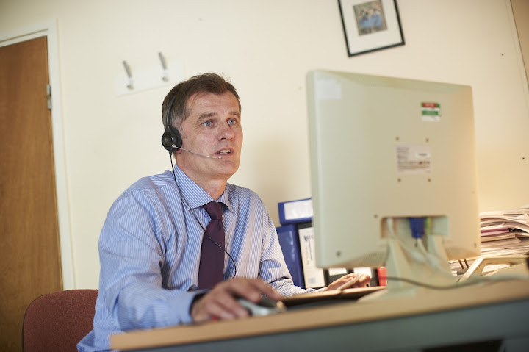
Remember!
Employers may:
Skim CV (15 seconds?)to make a decision
Take into account general presentation
Look for key words
Use software to scan for key
points or spelling/grammar
errors

Slide 36
Covering Letters: The Basics
Your chance to show interest, motivation and enthusiasm for the job
Tailor/personalise your letter to fit the job/company
Usually 1 side of A4 and occasionally:
A handwritten letter of application
A longer letter of application
Layout: Your address in top right of page, employer’s in top left
Include the date
Include reference to vacancy
Write to a named person if possible
Correct valediction: ‘Yours sincerely’ or ‘Yours faithfully’
Check for spelling, grammar, typos & keep a copy

Slide 37
Covering Letters: Content
Introduction
Who you are and why you are writing
Why you are interested in this job and this employer
Show interest and knowledge of the company and post (targeted, well researched application)
Why you are suited to this job
Highlight your strengths, skills and experience relevant to the job
Refer to sections of your CV – don’t repeat verbatim
Conclusion
End on a positive note

Slide 38
Keep a record of what you have done on your Employability Plan (accessed through the Employability Tutorial
http://vle.york.ac.uk/
This will help your supervisor know more about you and help him/her write your reference.

Slide 39

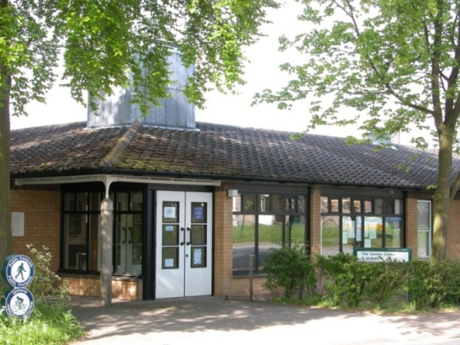
Support from the Careers Service www.york.ac.uk/careers
Talk to a Careers adviser or CV assistant – short appointments daily at Careers Service – book online
Talk to our Information Staff – no appointment needed
Information online and at the Careers Service
Programme of careers events, fairs, courses & workshops
www.facebook.com/yorkcareers
Location: behind the Berrick
Saul Building, near Market
Square shops

Slide 40

Tell us what you want…
If you have feedback on this session, any of our services, or ideas for future activities, please email: careers@york.ac.uk

